Slide 1
Final Exam Review
courtesy of Joe Hellerstein for some slides
Jianlin Feng
School of Software
SUN YAT-SEN UNIVERSITY
Notes:
1

Slide 2
Topics Covered
Relational Model
Disks, Files, Buffers, Indexes
Languages: Algebra, Calculus, SQL
Query Processing: Sorting, Hashing, Join Algorithms
Query Optimization
Schema Refinement and Normalization
Concurrency Control
Crash Recovery
Security
Data Warehousing

Slide 3
Overview
Purpose of this course: give students both
  An understanding of what systems do, why we use them, and how to use common databases efficiently,
  and an understanding of how databases work internally.

Slide 4
Introduction
What are databases?
Data models
What does a DBMS provide that the OS does not?
  Levels of Abstraction, Data Independence, Concurrency Control, Crash Recovery, etc.

Slide 5
Introduction (Contd.)
schemas & data independence
  conceptual schema
  physical schema
  external schema (view)
  logical & physical data independence

Slide 6
The Relational Data Model Basics
Components of the model:
  Relations, Attributes, Tuples
SQL Data Definition Language
Integrity Constraints
  how do they come into being?
  understand what you can learn from schema vs. instance!
Referential Integrity
  a state which holds when all foreign key constraints are enforced.

Slide 7
Relational Model (Contd.)
Keys, Primary Keys, Foreign Keys, Candidate Keys
Foreign key : Set of fields in one relation that is used to `refer’ to a tuple in another relation.
  Must correspond to primary key of the second relation.
  Like a `logical pointer’.
A set of fields is a key for a relation if :
  1. No two tuples can have same values in all key fields, and
  2. This is not true for any subset of the key.
  Part 2 false? A superkey.
  If there’s >1 key for a relation, all are candidate keys. One of the candidate keys is chosen to be primary key.
E.g., sid is a key for Students. (What about name?) The set {sid, gpa} is a superkey.

Slide 8
The Entity-Relationship Data Model
Typically also tool for conceptual design
Components of the model:
  Entities, Attributes, Relationships
  Cardinality of relationships, key constraints
  Participation Constraints
  Weak entities
Be able understand an E-R diagram
Be able to translate an E-R Diagram into Relational schema
Be able to modify an E-R diagram

Slide 9
Memory Management
Hierarchy of storage: RAM, Disk, Tape
Advantages/disadvantages of different types of storage .
Buffer management
  You should know basics from project!
    Understand data structures required
    notions of replacement, dirty pages, pinning pages
  Understand different replacement policies
    LRU, MRU, CLOCK
    be able to simulate each, understand pros, cons!

Slide 10
Memory Management (Contd.)
Organizing records in pages
  Fixed & variable-length fields in tuples
    2 alternatives for variable-length fields
  Fixed & variable-length tuples on pages
    know what a RID is, how it interacts with page layout
    know details of “slotted page” with slot directory
Organizing pages in files

Slide 11
File Organization
Different file organizations: heap files, sorted files, hashed files
  be able to compute costs of operations over each!
Access costs for different organizations

Slide 12
File Organization: Indexes
Understand search keys (vs. key constraints!)
3 alternatives for data entries
  Data record with key value k
  <k, rid of data record with search key value k>
  <k, list of rids of data records with search key k>
  Choice of alternative orthogonal to indexing technique!

Slide 13
Tree Structured Indexes
Trees do range and equality search
ISAM, rules for adding and removing entries
B-Trees, rules for adding entries
  You do not have to do “coalescing” on B+-tree deletion

Slide 14
B+ Tree Structure
Each node contains d <= m <= 2d entries (index or data)
  The parameter d is called the order of the tree.
  Each internal node contains m index entries: <key, page id>.
  Each leaf node contains m data entries: <key, record or record id>
The ROOT node contains between 1 and 2d index entries.
  It is a leaf or has at least two children.
Each path from the ROOT to any leaf has the same length.
Supports equality and range-searches efficiently.
Index Entries
(Direct search)
Data Entries
("Sequence set")
Notes:
9

Slide 15
External Sorting, Hashing
How to sort any file using 3 memory Pages
How to sort/hash in as few passes given some amount of memory
Relationship between buffers of memory, size of file, and number of passes to merge
Duality of sort and hash
Application to duplicate elimination, group by

Slide 16
Relational Algebra
Query language operating on relations
Know the operators!
  σ, π, ×, ∪, ∩, −, ρ,
  know schemas of output relations
  know varieties of joins
    (conditional vs. equi vs. natural), division
  be able to express complex operations in terms of simple ones
Use relational algebra to express queries written in English, and vice versa.

Slide 17
Relational Calculus
Declarative query language for tuples
formulas, operators, in, not, there-exists, for-all
Use relational calculus to express simple queries written in English, and vice versa

Slide 18
SQL
DDL: “Create Table”
DML: Delete From, Insert Into, Update
Basic Query:
  select <targets>
  from <relations>
  where <qualification>
Use of Distinct clause
Set operations: Union, Except, Intersect

Slide 19
SQL Query Language
basic queries
conceptual evaluation
range variables
expressions
strings
Union, Intersect, In, Except, Exists
nested queries, correlated and not
set comparison
Aggregation
  operators: Count, Avg, Any
  Group By, Having

Slide 20
Conceptual SQL Evaluation
SELECT [DISTINCT] target-list
FROM relation-list
WHERE qualification
GROUP BY grouping-list
HAVING group-qualification
Project away columns
(just keep those used in SELECT, GBY, HAVING)
SELECT
[DISTINCT]
Eliminate duplicates
Apply selections
(eliminate rows)
WHERE
HAVING
Eliminate groups
Relation cross-product
FROM
GROUP BY
Form groups & aggregate

Slide 21
Conceptual SQL Evaluation
SELECT [DISTINCT] target-list
FROM relation-list
WHERE qualification
GROUP BY grouping-list
HAVING group-qualification
ORDER BY
Project away columns
(just keep those used in SELECT, GBY, HAVING)
SELECT
[DISTINCT]
Eliminate duplicates
Apply selections
(eliminate rows)
WHERE
HAVING
Eliminate groups
Relation cross-product
FROM
GROUP BY
Form groups & aggregate

Slide 22
SQL Continued
Aggregation
  Count, Sum, Avg, Max, Min
  Group By, Having clauses
Nested Queries
  in Where or From Clause
  set comparison:
    In, Exists, Unique
    op Any, op All
  correlated vs. uncorrelated

Slide 23
Implementation of Relational Operators
Important Operators:
  Selection
  Projection
  Set operations
    Set-Difference, Union
  Aggregation
  Join
Understand cost estimation, selectivity

Slide 24
Selection
with no index, scan entire relation
with clustered index, use index
with unclustered index, sort rids
hash index only good for equality selection
with multiple selection conditions, either
  scan entire table testing all conditions
  use index on most restrictive condition first, scan result for other conditions
  use index for each condition, do set intersection on RIDs

Slide 25
Projection
Hard part: removing duplicates (if necessary)
Can remove duplicates by sorting or hashing
If index contains projected attr, can do index-only scan

Slide 26
Set Operations & Aggregation
Set operations:
  Intersection, cross product treated like joins
  Union (Distinct) and Set Difference both involve finding duplicates between two sets, treat similar to Project
Aggregation
  without Group By, must scan entire relation
  with Group By, could sort, then scan
    Or…?

Slide 27
Joins
Two relations: inner N and outer M
Simple Nested Loops:
  for each outer tuple, scan inner for matches
  cost:M + #tuples in M * N
Paged Nested Loops
  for each page in M, scan inner for matches to any tuple in that M page
  cost: M + M*N
Blocked Nested Loops
  like paged, except put as much of M in memory as possible, leaving 1 page for N and 1 page for output
  cost: M + (M/(block size)) * N

Slide 28
Joins (Contd.)
Indexed Nested Loops
  for each tuple in M, use index to find matches in N
  cost: M + #tuples in M * cost to use index to get tuples
Sort-Merge Join
  Sort each table, merge finding like values,
  can be bad if many duplicates
  cost: M log M + N log N + M + N
Hash Join
  partition both relations into buckets, read in one bucket from M at a time, match with elements from same bucket in N
  cost: partioning 2*(M + N) plus matching (M + N)

Slide 29
Query Optimization
Some operations are commutative, associative
May change the order of many operations in query
Dramatic changes in cost depending on operation order
“Query Plan” - a tree of operations indicating operation implementations and order
Ideally find optimal plan
In reality avoid terrible plans

Slide 30
Optimizer Implementation
need iterator interface so each operation passes tuples on to the next
need cost estimator to determine costs of different plans
  Reduction Factor of operations
need statistics and catalogs to estimate costs

Slide 31
System R Optimizer in Action
convert SQL to relational algebra
find alternate plans
  for each relation, consider all access paths
  for multiple relations, consider different join algorithms, access paths
  for join orders, only consider left-deep trees

Slide 32
Functional Dependencies (FDs)
An FD X → Y holds over relation schema R if, for every allowable instance r of R:
  t1 ∈ r, t2 ∈ r, π_{X} (t1) = π_{X} (t2)
  implies π_{Y} (t1) = π_{Y} (t2)
  (t1, t2 are tuples; X, Y are sets of attributes)
In other words: X → Y means
  Given any two tuples in r,
  if the X values are the same,
  then the Y values must be the same.
  (but not vice versa)
Read “→” as “determines”

Slide 33
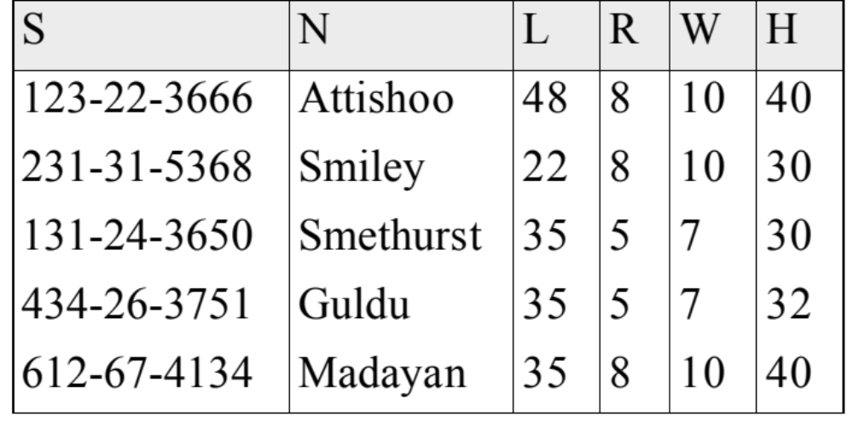
Problems Due to R → W
Hourly_Emps
Update anomaly: Can we modify W in only the 1st tuple of SNLRWH?
Insertion anomaly: What if we want to insert an employee and don't know the hourly wage for his or her rating? (or we get it wrong?)
Deletion anomaly: If we delete all employees with rating 5, we lose the information about the wage for rating 5!

Slide 34
Rules of Inference
Armstrong's Axioms (X, Y, Z are sets of attributes):
  Reflexivity: If X ⊇ Y, then X → Y
  Augmentation: If X → Y, then XZ → YZ for any Z
  Transitivity: If X → Y and Y → Z, then X → Z
Sound and complete inference rules for FDs!
  using AA you get only the FDs in F+ and all these FDs.
Some additional rules (that follow from AA):
  Union: If X → Y and X → Z, then X → YZ
  Decomposition: If X → YZ, then X → Y and X → Z

Slide 35
Attribute Closure
Computing closure F⁺ of a set of FDs F is hard:
  exponential in # attrs!
Typically, just check if X → Y is in F⁺. Efficient!
  Compute attribute closure of X (denoted X⁺) wrt F.
  X⁺ = Set of all attributes A such that X → A is in F⁺
    X⁺ := X
    Repeat until no change:
    if U → V ⊆ F, U ⊆ X⁺, then add V to X⁺
  Check if Y is in X⁺
  Approach can also be used to find the keys of a relation.
    If X⁺ = R, then X is a superkey for R.
    Q: How to check if X is a “candidate key”?

Slide 36
Boyce-Codd Normal Form (BCNF)
Reln R with FDs F is in BCNF if, for all X → A in F+
  A ⊆ X (called a trivial FD), or
  X is a superkey for R.
In other words: “R is in BCNF if the only non-trivial FDs over R are key constraints.”

Slide 37
Decomposition of a Relation Scheme
How to normalize a relation?
  decompose into multiple normalized relations
Suppose R contains attributes A1 ... An.
A decomposition of R consists of replacing R by two or more relations such that:
  Each new relation scheme contains a subset of the attributes of R, and
  Every attribute of R appears as an attribute of at least one of the new relations.

Slide 38
Lossless Join Decompositions
Decomposition of R into X and Y is lossless-join w.r.t. a set of FDs F if, for every instance r that satisfies F:
  π_{x}(r) ⋈ π_{Y}(r) = r
It is always true that r ⊆ π_{x}(r) ⋈ π_{x}(r)
  In general, the other direction does not hold!
  If it does, the decomposition is lossless-join.
Definition extended to decomposition into 3 or more relations in a straightforward way.
It is essential that all decompositions used to deal with redundancy be lossless! (Avoids Problem #1)

Slide 39
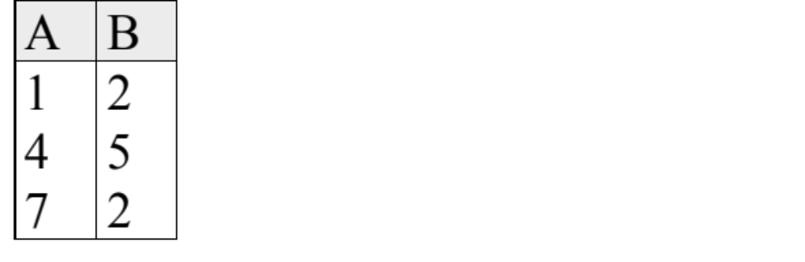
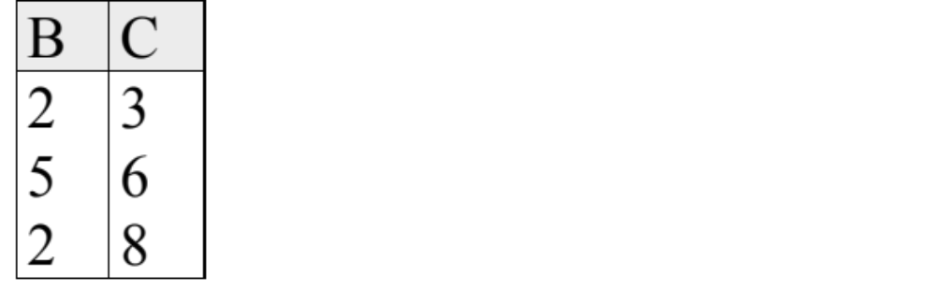
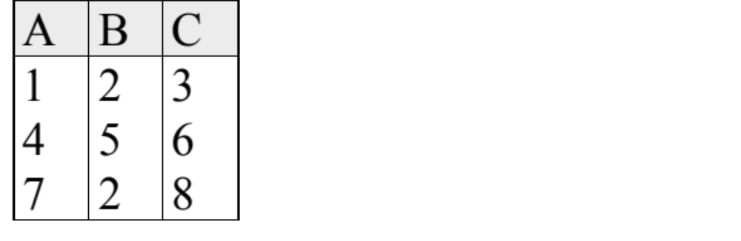
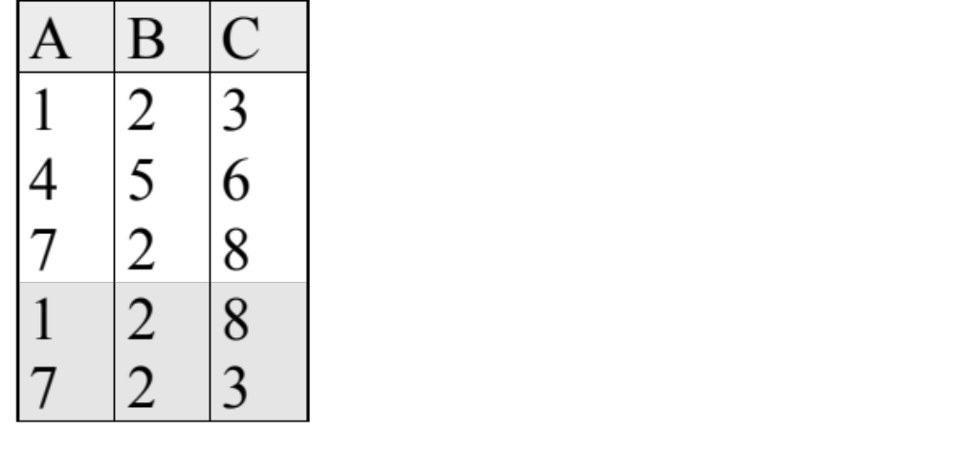

Lossy Decomposition (example)
A → B; C → B
=

Slide 40
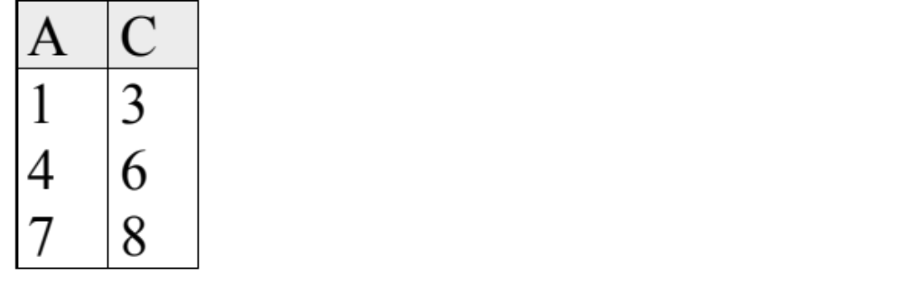
Lossless Decomposition (example)
A → B; C → B
=
But, now we can't check A → B without doing a join!

Slide 41
Dependency Preserving Decompositions (Contd.)
Decomposition of R into X and Y is dependency preserving if (F_{X} ∪ F_{Y} ) ⁺ = F ⁺
  i.e., if we consider only dependencies in the closure F ⁺ that can be checked in X without considering Y, and in Y without considering X, these imply all dependencies in F ⁺.
  (just the formalism of our intuition above)
Important to consider F ⁺ in this definition:
  ABC, A → B, B → C, C → A, decomposed into AB and BC.
  Is this dependency preserving? Is C → A preserved?????
Note: F ⁺ contains F ∪ {A → C, B → A, C → B}, so…
  F_{AB} ⊇ {A →B, B → A}; F_{BC} ⊇ {B → C, C → B}
  So, (F_{AB} ∪ F_{BC})⁺ ⊇ {C → A}

Slide 42
Third Normal Form (3NF)
Reln R with FDs F is in 3NF if, for all X → A in F⁺
  A ∈ X (called a trivial FD), or
  X is a superkey of R, or
  A is part of some candidate key (not superkey!) for R.
  (sometimes stated as “A is prime”)
Minimality of a candidate key is crucial in third condition above!
If R is in BCNF, obviously in 3NF.
If R is in 3NF, some redundancy is possible. It is a compromise, used when BCNF not achievable (e.g., no ``good'' decomp, or performance considerations).
  Lossless-join, dependency-preserving decomposition of R into a collection of 3NF relations always possible.

Slide 43
Minimal Cover for a Set of FDs
Minimal cover G for a set of FDs F:
  Closure of F = closure of G.
  Right hand side of each FD in G is a single attribute.
  If we modify G by deleting an FD or by deleting attributes from an FD in G, the closure changes.
Intuitively, every FD in G is needed, and ``as small as possible'' in order to get the same closure as F.
e.g., A → B, ABCD → E, EF → GH, ACDF → EG has the following minimal cover:
  A → B, ACD → E, EF → G and EF → H
M.C. implies Lossless-Join, Dep. Pres. Decomp!!!
  (in book)

Slide 44
Concurrency Control
Transaction: basic unit of operation
  made up of reads and writes
Goal: ACID Transactions
A & D are provided by Crash Recovery
C & I are provided by Concurrency Control
Bottom line: reads and writes for various transactions MUST be ordered such that the final state of the database is the same as some serial ordering of the transactions

Slide 45
Approaches to Concurrency Control
2PL - all objects have Shared and eXclusive locks
  once one lock is released, no more locks may be acquired
  Strict 2PL: don’t release locks until commit time
Locking issues
  must either prevent or detect deadlock
  may want multiple granularity locks (table, page, record) using IS, IX, SIX, S, X locks (check compatibility matrix!)
  locking in B-trees usually not 2PL
  phantom problem: locking all records of a given criteria (e.g., age > 20)

Slide 46
Crash Recovery
ACID - need way to ensure A & D
We studied approach of Aries system
Buffer management Steal, no Force
Every Write to a page is first logged in WAL
  log record is in stable storage before data page on disk
  log record has Xact#, before value, after value
Checkpoints record which pages dirty, which XActs running

Slide 47
Transaction Commit
write Commit record to log
flush log tail to stable storage
remove Xact from Xact table
write End record to log

Slide 48
Transaction Abort
write Abort record to log
go back through log, undoing each write (and add CLR to log)
when done, write End record to log

Slide 49
Crash Recovery - 3 phases
Analysis: starting from checkpoint, go forward in the log to see:
  what pages were dirty
  what transactions were active at time of crash
Redo: start from oldest log record (oldest recLSN) that wrote to a dirty page, and redo all writes to dirty pages.
Undo: start at the end of the log (time of crash), work backward undoing all writes made by transactions that were active at time of crash

Slide 50
Security and Authorization
Three main security objectives:
  secrecy, integrity, availability.
DBA is responsible for overall security.
  Designs security policy, maintains an audit trail, or history of users’ accesses to DB.
Two main approaches to DBMS security: discretionary and mandatory access control.
  Discretionary control based on notion of privileges.
  Mandatory control based on notion of security classes.

Slide 51
Warehousing
Data warehouses are large, consolidated data repositories built for decision support.
Warehouses exploited using sophisticated analysis techniques:
  Data Warehousing Concepts and Architectures;
  Multi-Dimensional Data Model;
  Data Cube; ROLL-UP; DRILL-DOWN;
  Bitmap index
  View Materialization.

